Slide 1
Customizable Tools for Regulated Work
Jeffrey Plume

Slide 2
The problem with commercial software….
3D Visualizations
Annotations and Comments
API Integration
Audit Trails
Automation Services
Big Data Formats
Big Data Integration
Bookmarking and History
Bookmarks
Box Plots
Brush Linking
Bubble Charts
Caching
Cloud Deployment
Clustered Deployment
Clustering and Classification
Combination Charts
Conditional Alerts
Custom Expressions
Custom Expressions
Custom JavaScript Visualizations
Custom Map Layers
Custom Themes
Data Blending
Data Cleaning
Data Connectors
Data Encryption
Data Limiting
Data Marking
Data Masking
Data Mining
Data Normalization
Data Profiling
Data Relationships
Data Transformation
Data Wrangling
Drill Down
Drill-through Capabilities
Dynamic Controls
Email Notifications
ETL Capabilities
Extensions and SDK
Filter Panel
Forecasting
Geocoding
Geospatial Mapping
Heat Maps
Heat Maps and Density Maps
Heat Tables
Hierarchical Data Navigation
Histograms
In-Memory Analytics
Interactive Dashboards
Job Scheduling
KPIs and Gauges
Linked Visualizations
Load Balancing
Load Balancing
Machine Learning Integration
Mobile Access
On-Demand Data Access
On-demand Data Loading
Predictive Modeling
Python/R Scripting API
R and Python Integration
Real-time Alerts
Real-time Data Integration
Reports and PDF Export
Responsive Design
REST API
Role-based Access Control
Route and Path Analysis
Scatter Matrix
Scheduled Data Refresh
Scheduled Reports
Scripting
Sharing and Embedding
Spatial Functions
Spotfire Mobile
Statistical Analysis
Streaming Data
Structured Data
Tagging
Third-Party Integration
Time Series Analysis
Tree Maps
Unstructured Data
User Authentication
Virtual Data Layer
Waterfall Charts
Web-based Access
Does many things, but none of them well

Slide 3
“Do not try to do everything. Do one thing well” – Steve Jobs

Slide 4
CRF Part 11
Electronic Record
Data Storage
Electronic Signatures
CFR Part 11
Data Backup
Audit Trails
Digital Data Access

Slide 5
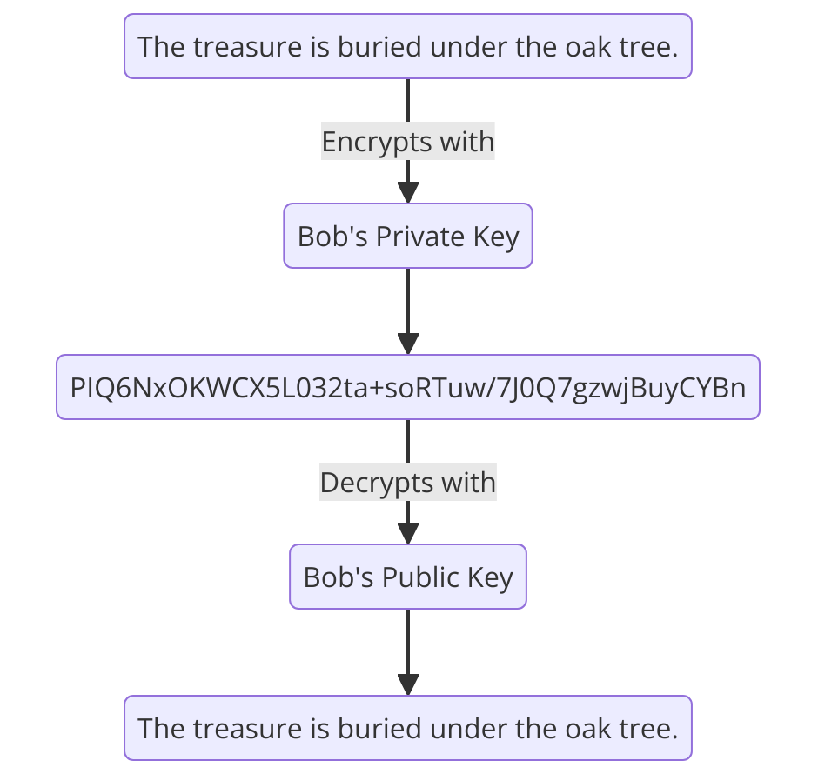
Cryptography Basics
A message encrypted with a private key can only be decrypted with the associated public key.
Private keys visible to owner. Public keys are shared.
This ensures that
Confidentiality
Authenticity

Slide 6
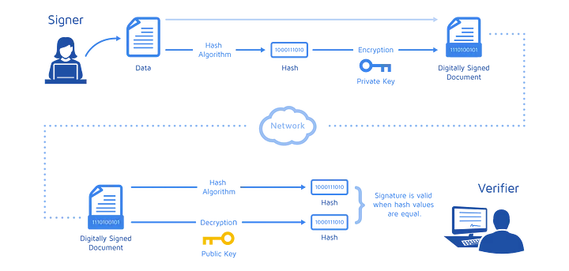
Digital Signatures
Digest hash:
Unique to the data
Irreversible
Hashes are encrypted with Private key
Verified by decryption with public key
Ensures
Data is not altered (hash)
Authentic (Key-pair)
https://www.docusign.com/how-it-works/electronic-signature/digital-signature/digital-signature-faq

Slide 7


User Database Structure
Username
Private keys are encrypted with separate master key
Username, salt, and hashed password grant access to master key during signing
Decrypted Private Key used to sign
Signature Verified with public key
Hashed Password
Public Key
User Database
Random Salt
Signature
Private keys
Private keys
KMS
Sign
Master
Encrypt
Decrypt

Slide 8
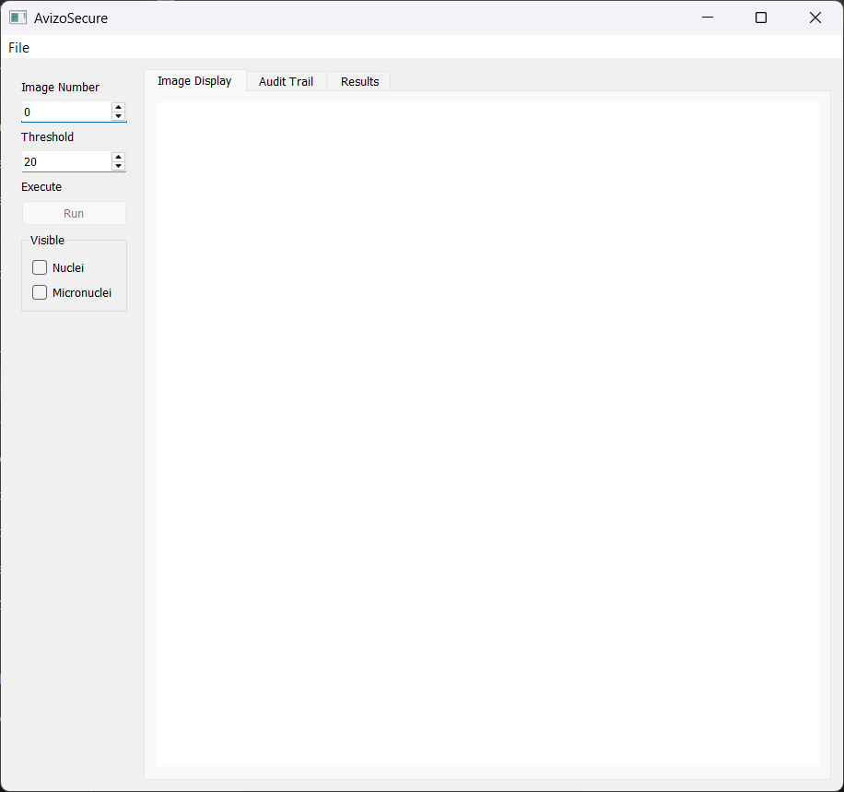
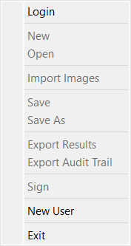
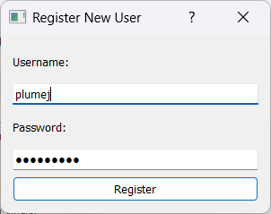
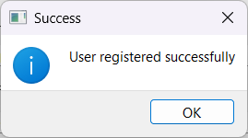
User Registration
Program opens in a locked state
Login
New User
Exit

Slide 9
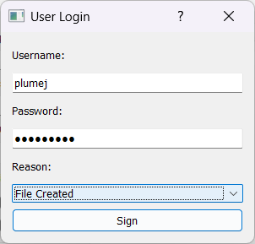
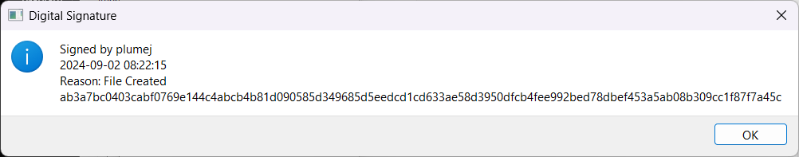
Login
Program opens in a locked state
Login
New User
Exit

Slide 10
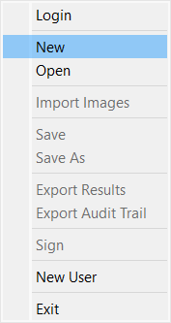
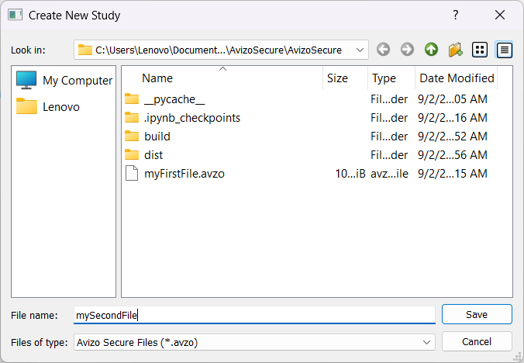
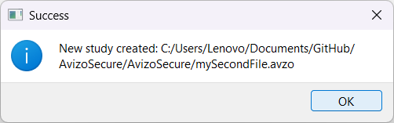
Create New
Two files created
*.avzo: structured SQL files with results and audit trail
*.avzodata: images and segmentation analysis

Slide 11
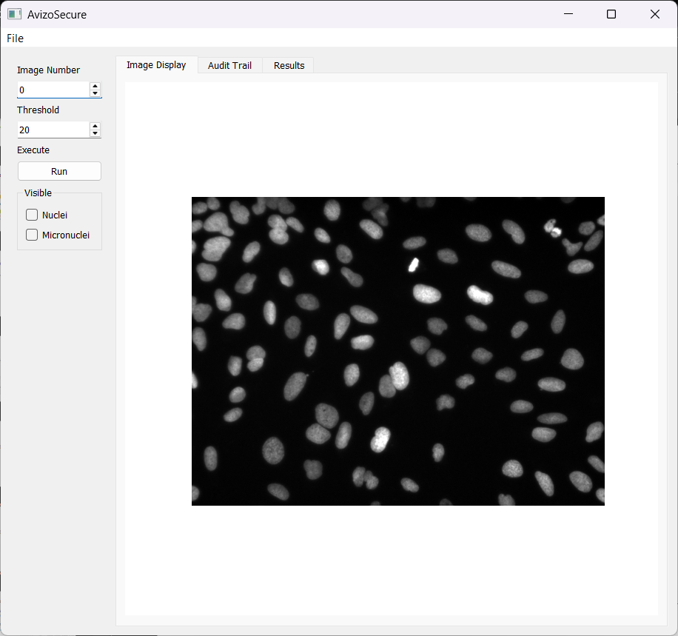
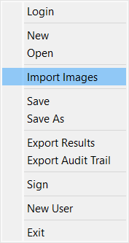
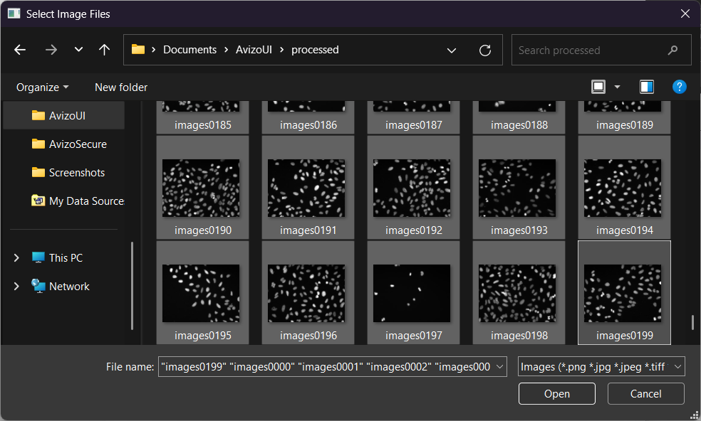
Import Images
Accepts common image formats
Toggle Between images with “File Number” toggle.

Slide 12
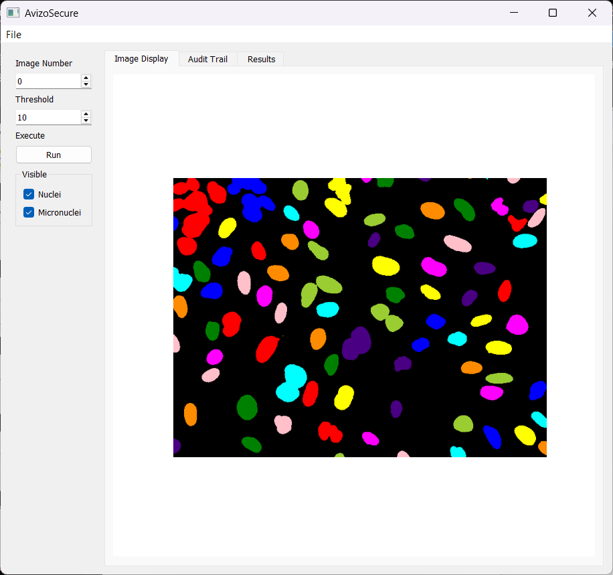
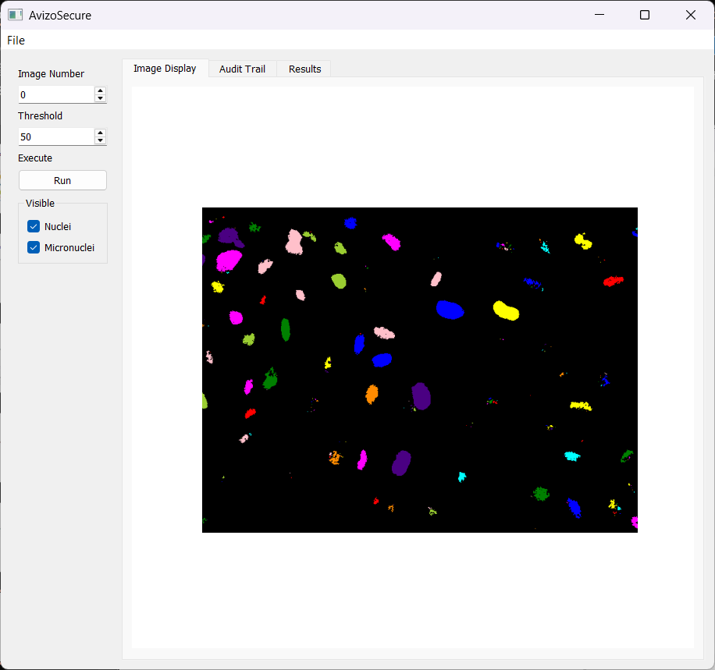
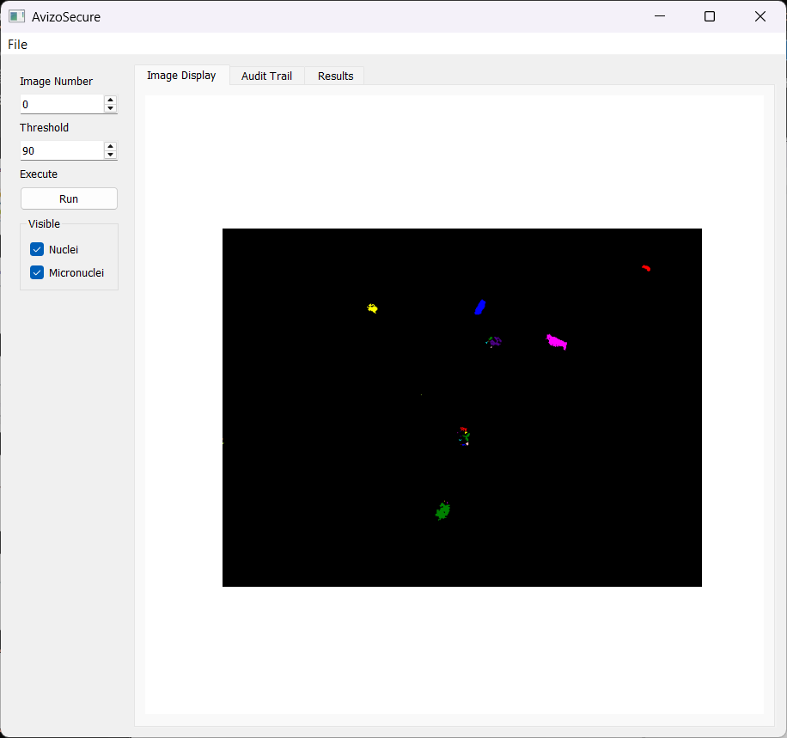
Analye
Threshold is scaled 0-100

Slide 13
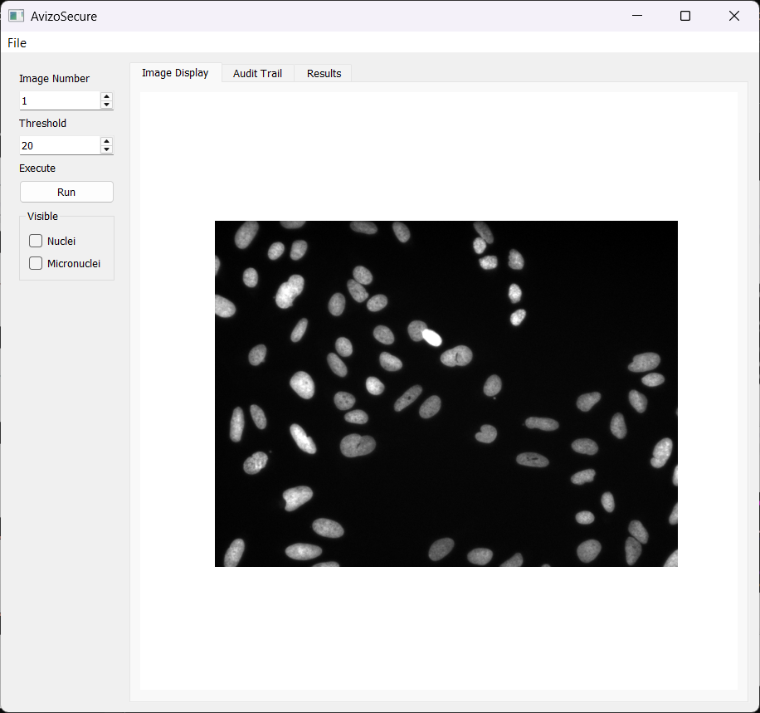
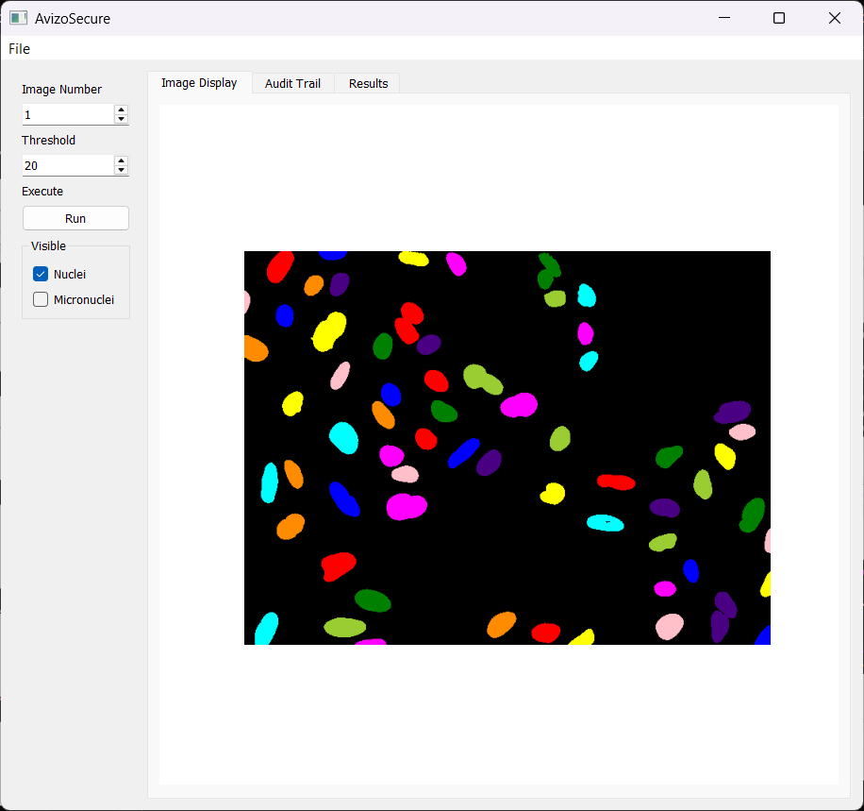
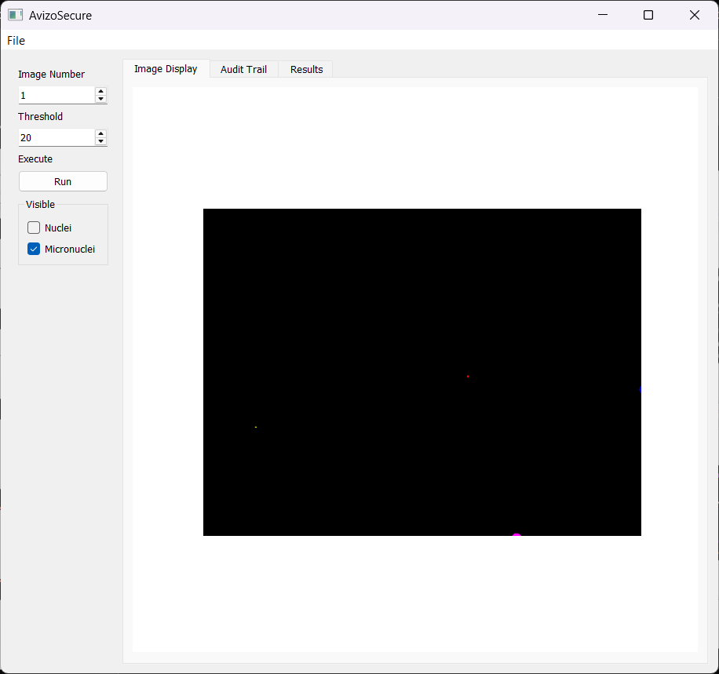
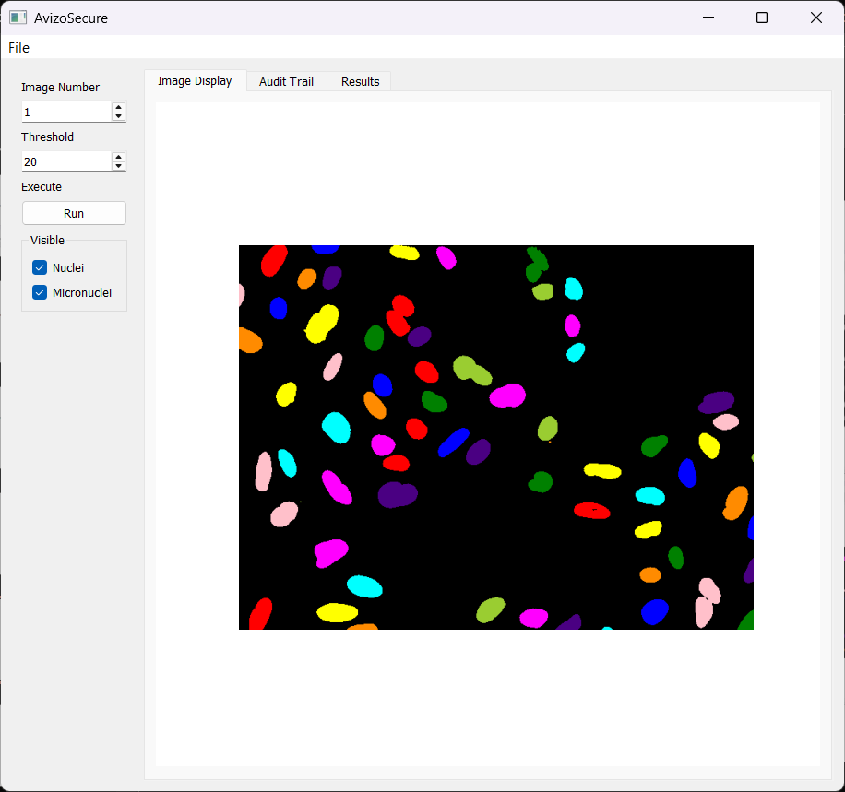
Toggle Views

Slide 14
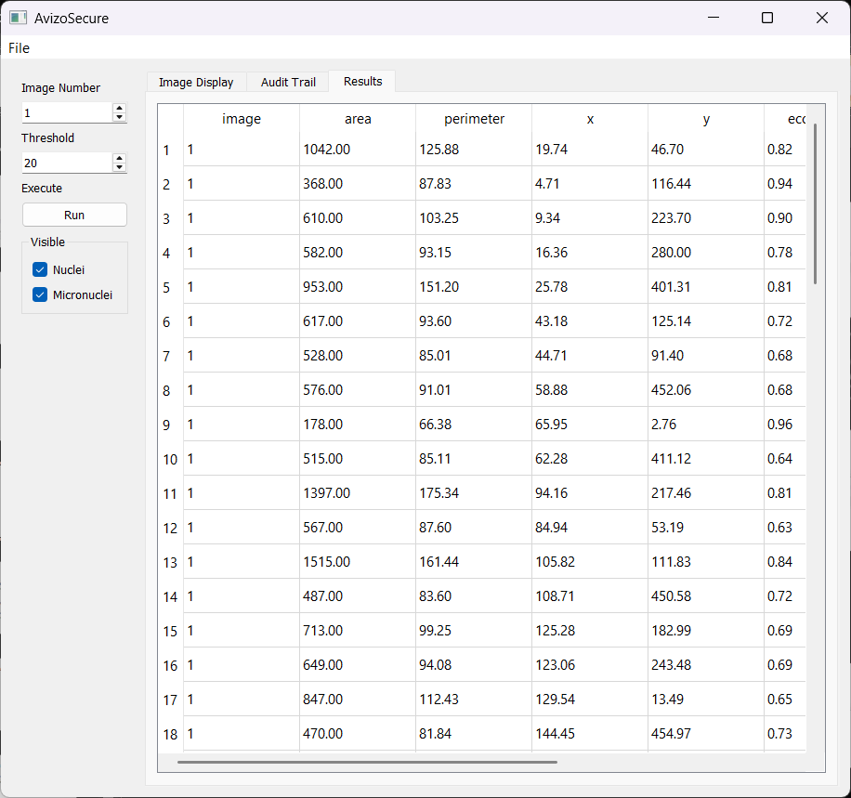
Results

Slide 15
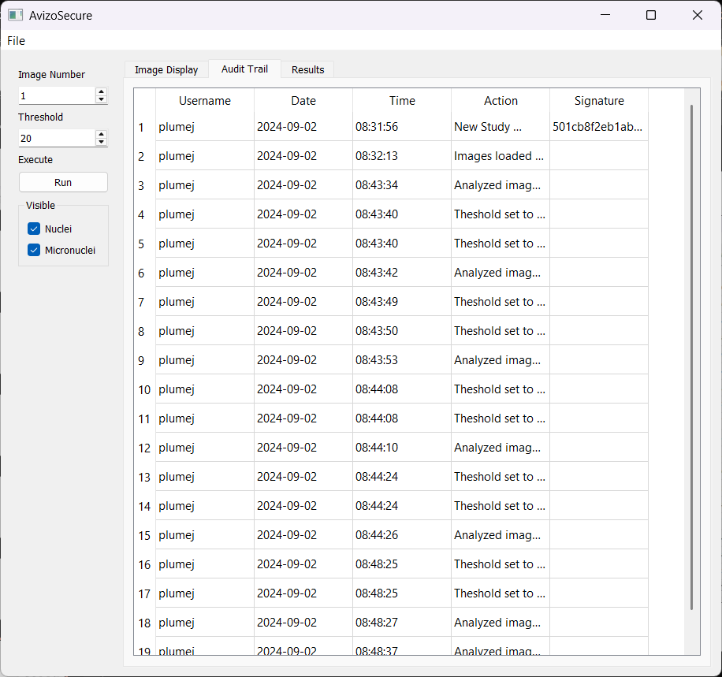
Audit

Slide 16
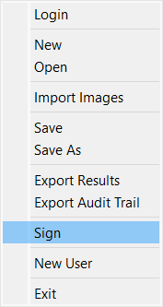
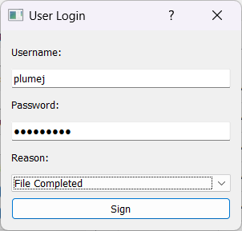
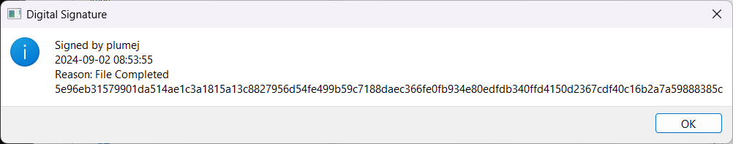
Signing

Slide 17
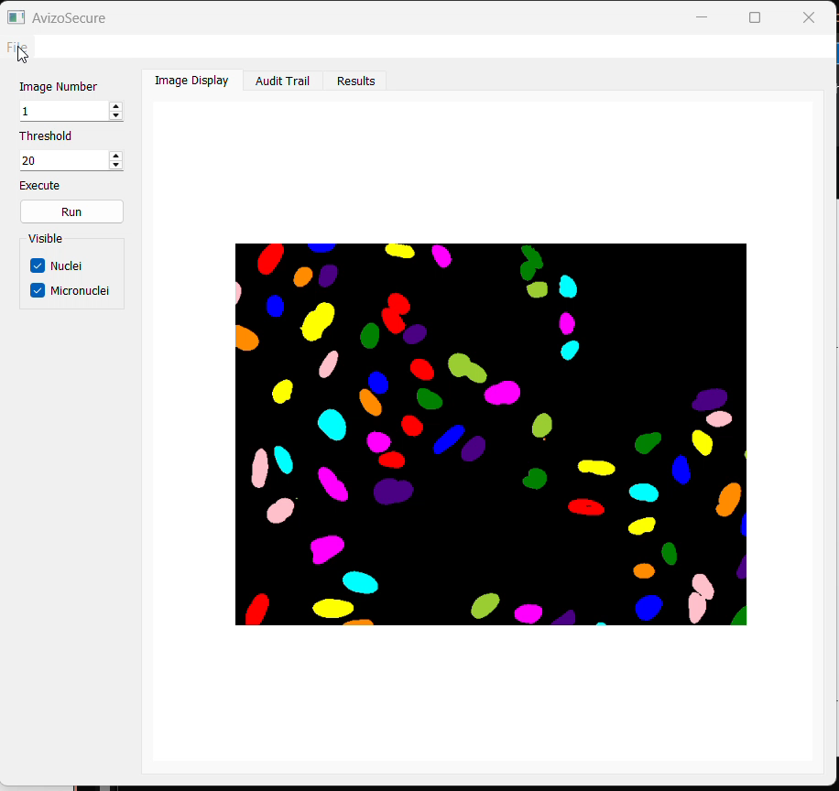
Additional Features
Save
Save As
Open
Export Audit Trail
Export to PDF (under construction)

Slide 18
Perspectives
Commercial tools are often designed to meet many needs but fail meet any well
Internally developed software, with quality systems, can be designed to meet Part 11 Compliance
Customized tools can be developed to meet unmet needs in a ways that address Part 11

